Slide 1

Unit I
Fashion Industry

Slide 2
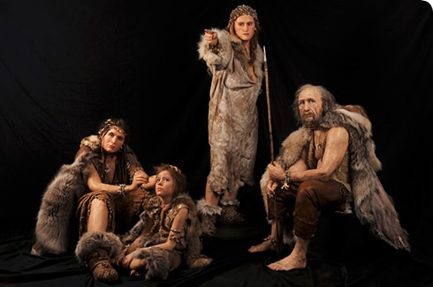
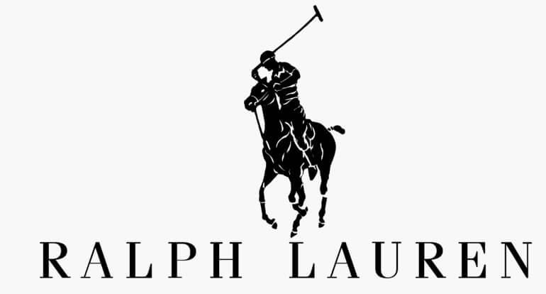
Fashion Industry
Origin of Fashion Industry
The fashion industry was created to:-
Design
Market
Manufacture,
And sell clothes, footwear, and accessories.
Prior to the creation of the apparel industry, people created clothes for themselves.
As the world evolved, the industry started production of clothing began roughly in the mid-nineteenth century. Some manufacturers began to produce garments.
Fashion only became an established industry in the twentieth century.
Networks of neighborhood tailors casually evolved into manufacturing businesses.
Factories grew from necessity during the world war 1 & 2 era.
The social and cultural changes of the time period started unilateral codes of dress.
Changes in the business of fashion, and the establishment of designers as arbiters of taste, began to take shape in the early part of the century, although largely led by European Fashion Houses.
In the 1950s and 1960s, a growing number of entrepreneurial designers began to make their way out of the backrooms to feature their own names on their labels.
During this time period, several fashion designers had become celebrities in their own right.
To name a few, Oscar de la Renta, Ralph Lauren, Bill Blass, Calvin Klein, and Halston.

Slide 3
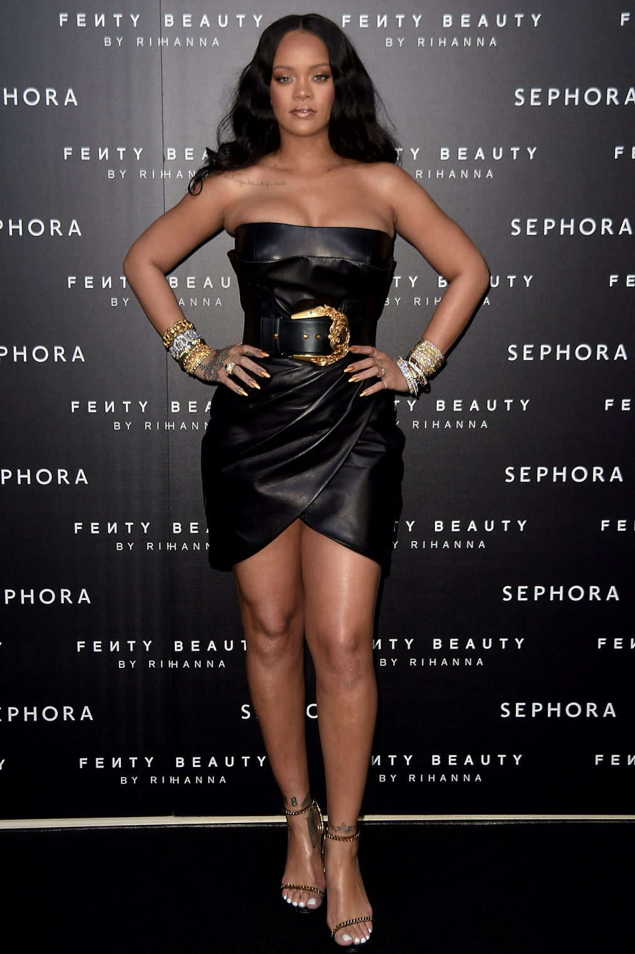
It is well known that high fashion typically travels by the speed of light.
New trends are starting each day and in all honesty it is often difficult to stay current on the latest fashion trends.
Fashion statements are being made be individuals nearly every moment of every day.
The fashion industry of the early 2000s is global for certain.
Garments are conceived, illustrated, and laser-cut by computers, and replenished automatically by a store's data system alerts.
In the modern world of fashion, the designers often compete directly with their biggest customers by opening flagships stores around the world, and sell product online.
The stores return the favor by competing with designers by sourcing and producing their own private label collections.
The retail stores often base their private label collection on the prevailing runway looks.
Magazine editors and stylists have gone on to become designers, while Hollywood actors and pop stars have gone from wearing designer clothes to creating them.
The industry is comprised of emerging designer as well as seasoned industry veterans.
At the outset of the twenty-first century, what defines the fashion industry has little to do with the artisan's craft of a century ago.

Slide 4
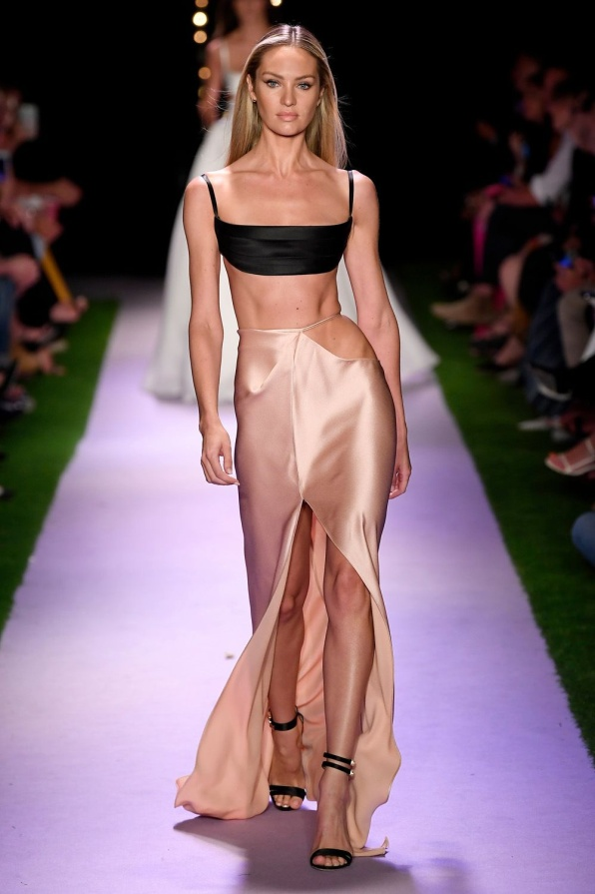
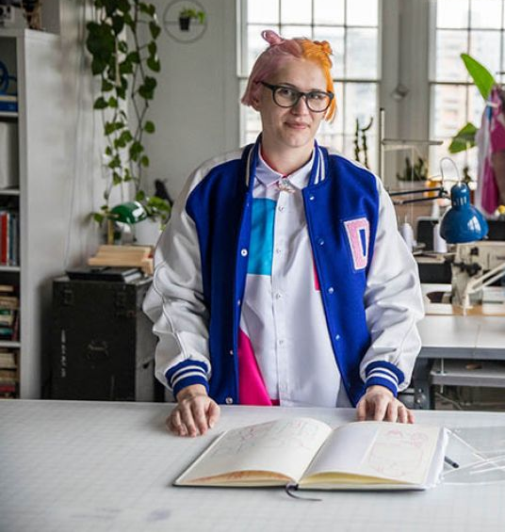
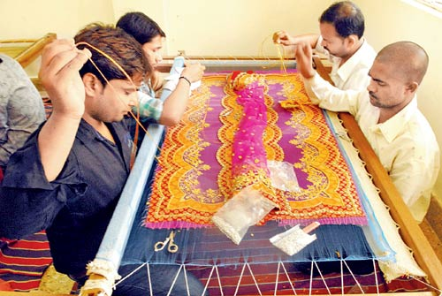
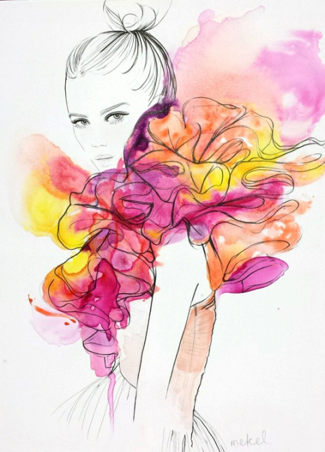
Parts of Fashion
What defines the fashion industry is largely based on the functions of the individuals who comprise it-
Designers,
Stores,
Factory workers,
Seamstresses,
Tailors,
Technically skilled embroiderers,
The press, publicists,
Salespersons
Fit models,
Runway models,
Couture models,
Textile manufacturers,
Pattern makers, and sketch artists.
In simplest terms, the fashion industry could be described as the business of making clothes, but that would omit the important distinction between fashion and apparel.
Apparel is functional clothing, one of humanity's basic needs, but fashion incorporates its own prejudices of style, individual taste, and cultural evolution.

Slide 5
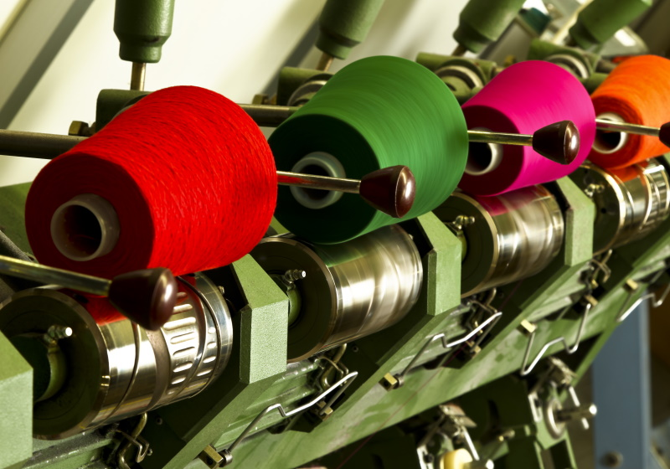
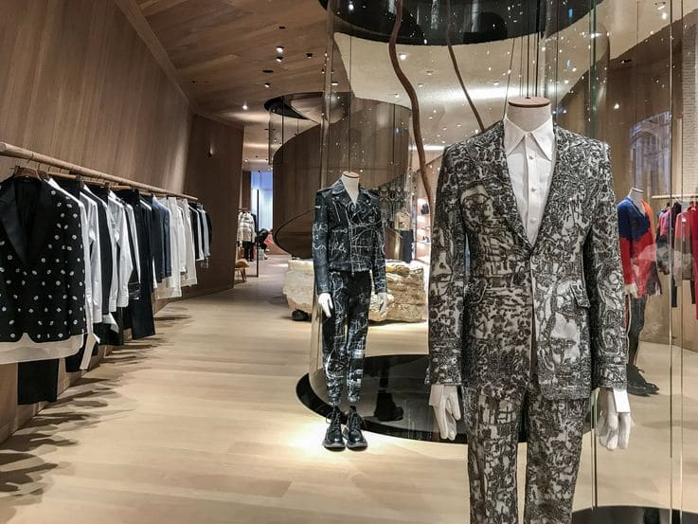
World Fashion Scenario
Structure
There are three levels of the fashion industry:
The primary level of textile production, including mills and yarn makers;
The secondary level of designers, manufacturers, wholesalers, and vendors; the retail level, which includes all types of stores and distribution points of sale;
The auxiliary level-which connects each of the other levels via the press, advertising, research agencies, consultants, and fashion forecasters who play a part in the merchandise's progression to the end consumer.
While the relationship between the levels is more or less symbiotic-they need one another to survive-historically, the competitive spirit of capitalism has also created a tension between retailer and manufacturer, where the balance of power is usually tipped to one side in the race to capture profits and margins. The degree to which each side benefits financially from the sale of apparel has changed gradually over the decades, subject to many factors from social advancements to economic swings to cults of designer personalities to wars-both between countries and conglomerates. Over the century, the retailer, in many cases, has taken on the role of the manufacturer, and manufacturers have become retailers of their own designs.

Slide 6
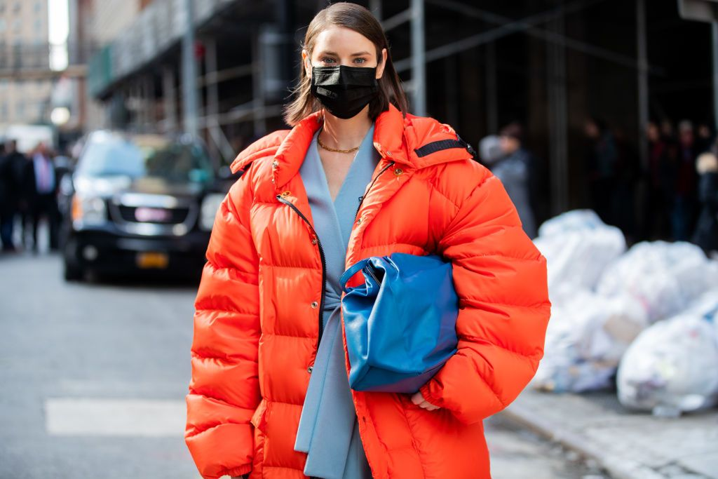
Future Prospect
The one major carry forward which the New Year 2021 will have from 2020 is the continuing impact of the COVID-19 pandemic, is the public health crisis is expected to impact economies for at least a couple of years to come.
The “New Normal” is here to stay, and like every industry, the fashion retail industry showed tremendous agility in adapting to the demands of the time.
From the tangible, brick and mortar stores to online shopping, the fashion retail space has been re-inventing, re-strategizing, and re-aligning themselves to rapidly evolving business environment and changing consumer needs.
With such a major carry forward, certain trends that are at a nascent or developing stage now will strengthen and grow next year.
While the supply chain and distribution network would have largely recovered and healed from the lockdown shock, public mobility and footfall are expected to remain impacted.

Slide 7
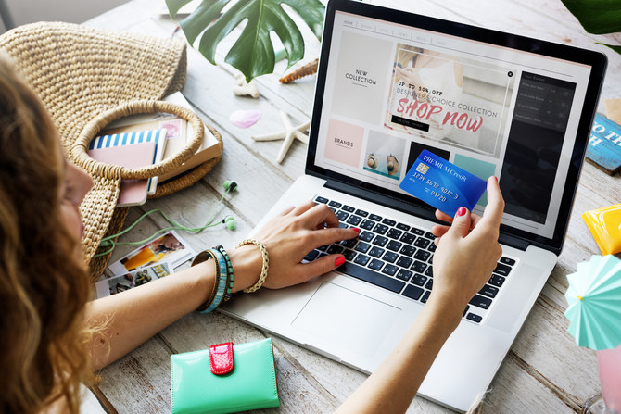
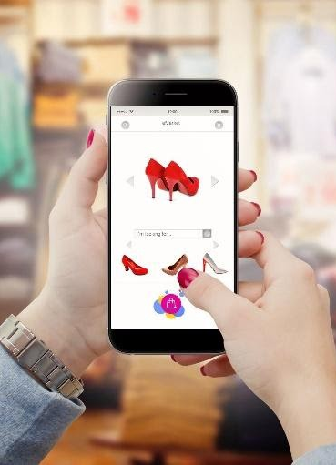
Online Shopping
Online shopping trends will strengthen and brands will focus on leveraging technologies to provide a seamless virtual shopping experience.
Digital Technologies
The adoption of digital technologies across industries would address multiple challenges and strengthen several aspects of the industry, including strengthening the supply chain and distribution network, accelerating digital marketing activities, directing sales, forecasting sales and revenue, and extending to consumers an exceptional shopping experience.
Rise of Artificial Intelligence
AI is one of the biggest developments for which the fashion retail industry is waiting. With people spending more time online, much of the action will be online. It will provide brands to capture more mind space for the customers. Fashion brands and data aggregators would be receiving huge volumes of data and insights into customer preference.

Slide 8
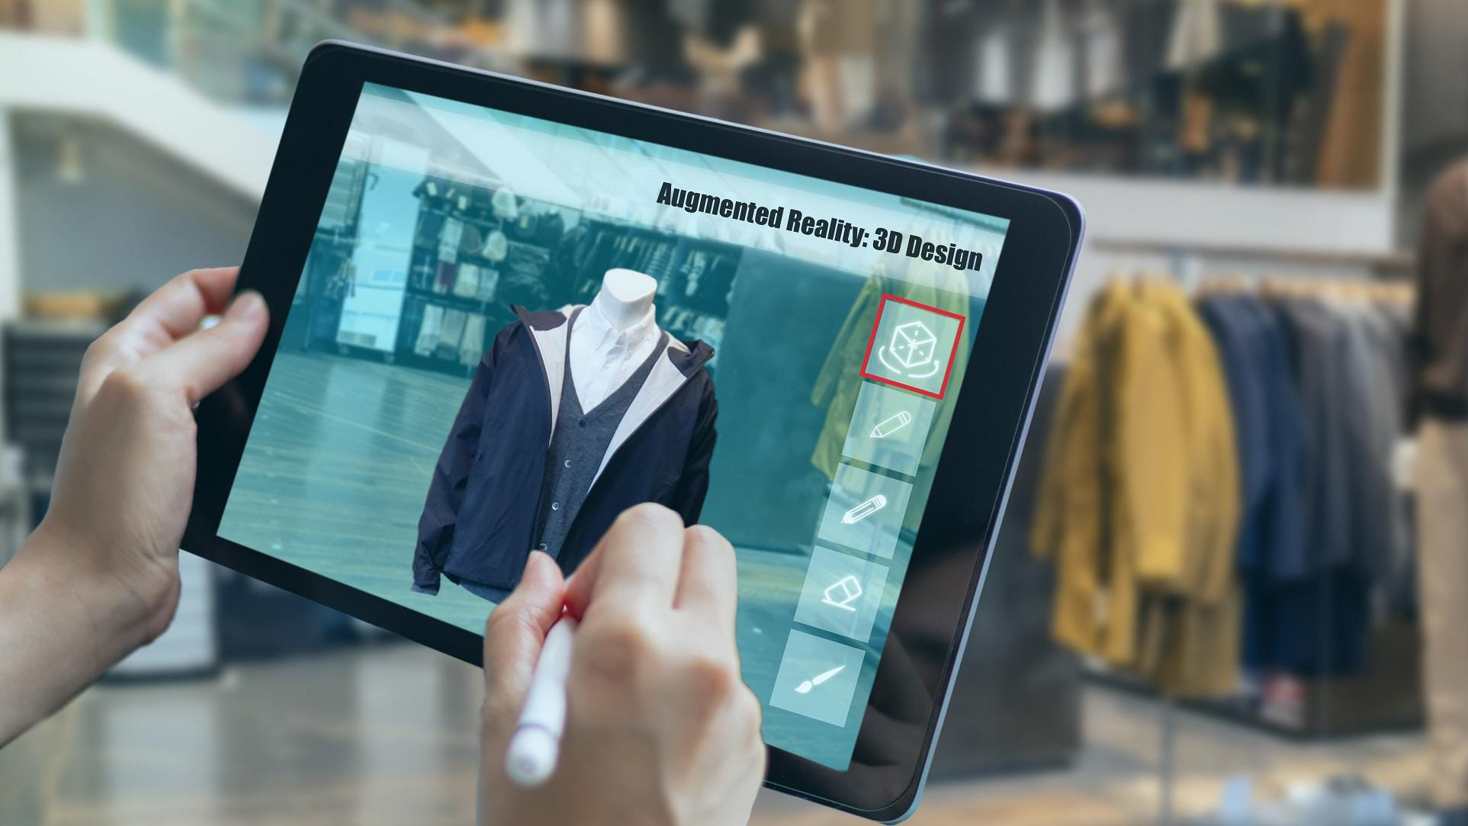
Automation
n times to come, predictive analysis will play an important role in determining the sales pipeline management and forecasting.
AR VR
Augmented and virtual reality are customer-oriented features that will revolutionize the way customers experience the brand online. They have been closing the gap for a number of years now. By using AR technology in the store, brands can allow customers to access any apparel through digital media while VR technology would help the users try outfits virtually.
Accelerated Digital Marketing
Digital marketing budgets are bound to increase more than what was expected during the pre-COVID era. A huge thrust would be to leverage all possible digital channels for attracting customers, driving sales, and most importantly continuing brand loyalty.

Slide 9
Unit II
Social Aspects of Clothing

Slide 10
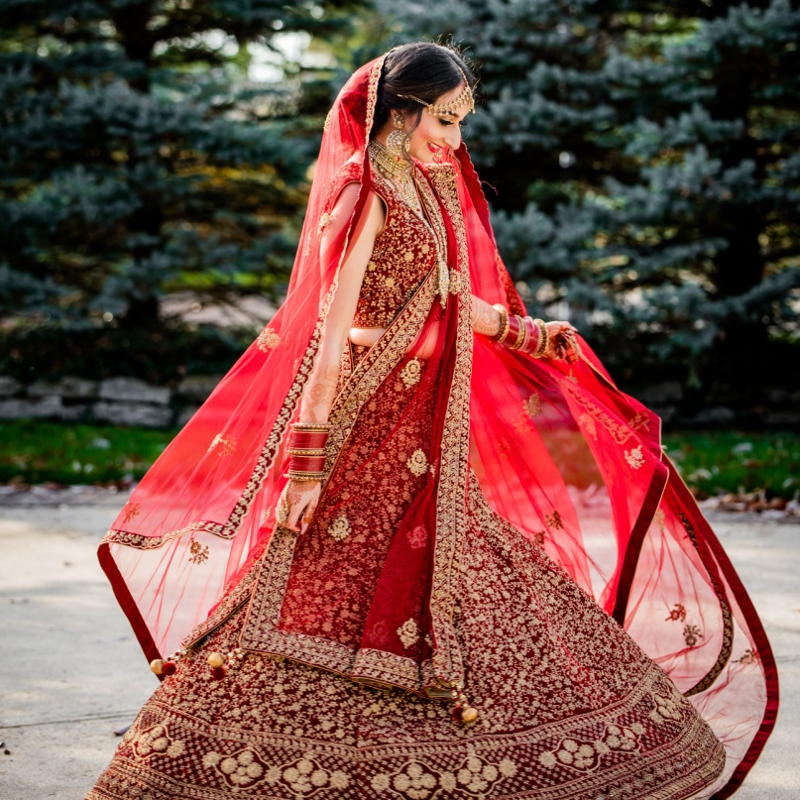
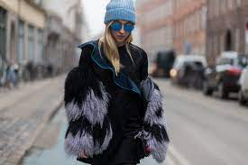
Social Aspects of clothing
People wear clothes in order to protect their bodies from natural conditions, like:
Heat,
Extreme cold weather,
Humidity,
Strong sunlight, are some of the reasons people have begun wearing clothes in the first place.
But human clothes have over the years evolved into a symbol in itself. Conveying a social message to a variety of decoders, clothes, accessories, and decorations, have become a reliable way to denote social status, occupation, economic situation, ethnicity, marital status, sexual orientation and religious affiliation. Thus, for different people around the globe, clothes have become one of the most crucial parts-if not the only one-of a person appearance.

Slide 11
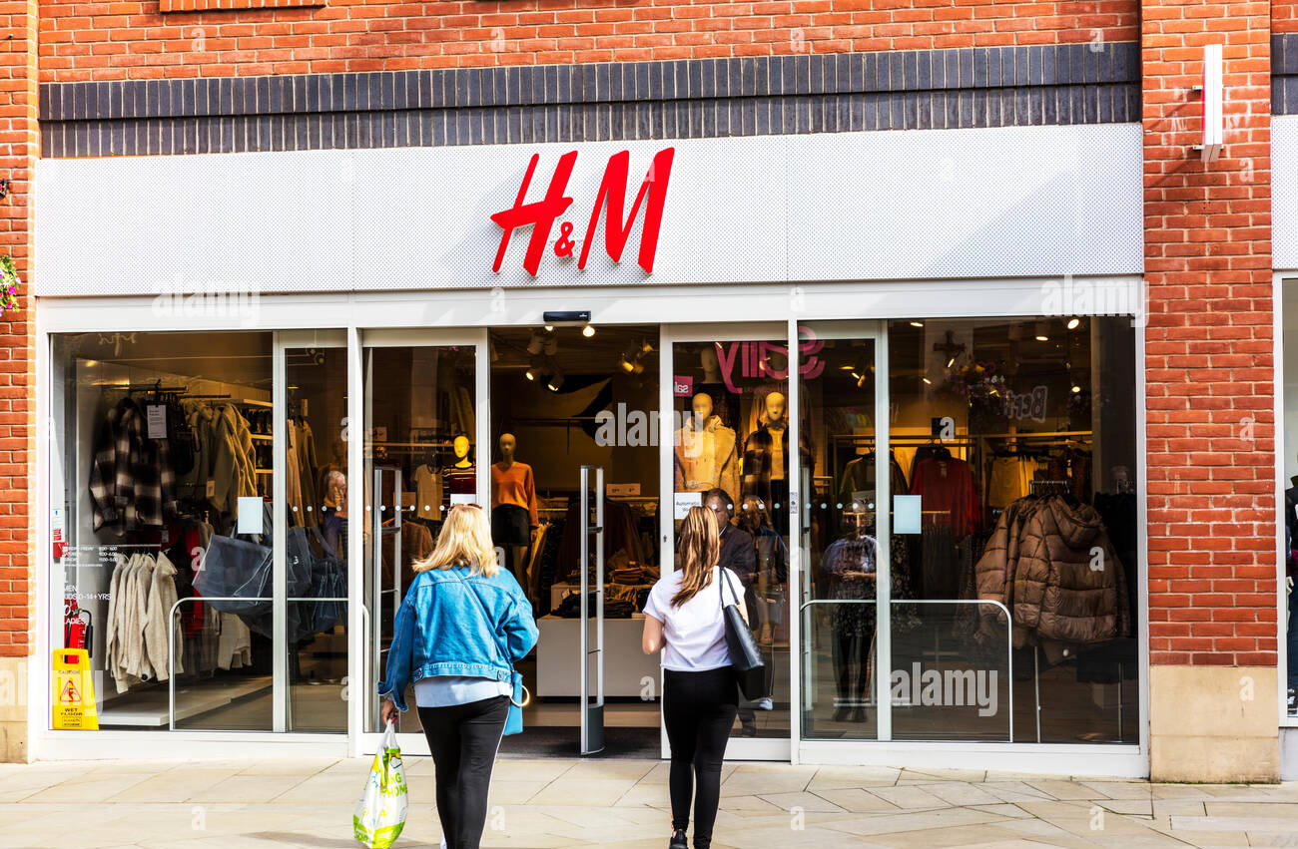
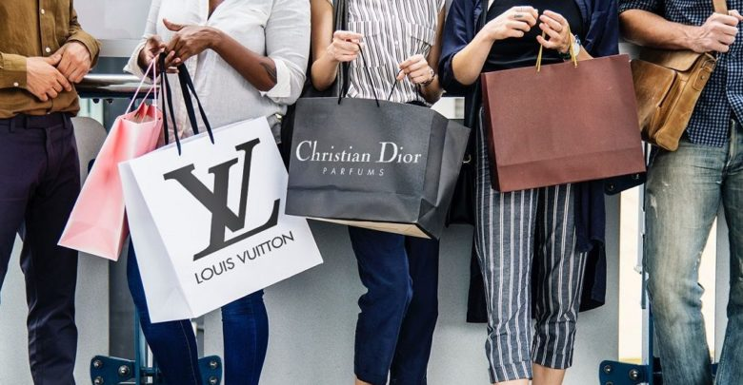
Private Label designer
There are many different types of private label products including apparel, accessories and footwear. What all these labels have in common is that they are manufactured by another company, but then sold under a store's name or brand: Target has their own line of clothes called C&A, H&M uses other companies to make their clothing.
One could say there are three levels:
White labelling - when one type of product is made for both brands;
Co-branded products where two competing brands share the same logo on an item such as Nike/Adidas;
Private branding where only one brand owns the product with no other company's logo on the item.
Brand Label Designer
The term designer label refers to clothing, luxury goods, personal accessory items sold under an often prestigious marque which is commonly named after a designer, founder, or a location- like where the company was founded

Slide 12

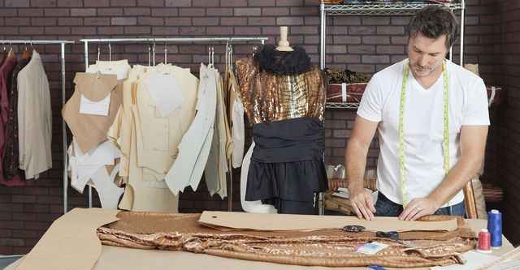
Freelance designer
A freelance graphic designer is a creative professional who produces designs using visuals. Their job is to assemble images and graphics creatively using tools and technology. Starting as a freelance graphic designer can unleash many emotions, from empowering to a terrifying experience.
Designer as manufacturer
An original design manufacturer is a company that designs and manufactures a product, as specified, that is eventually rebranded by another firm for sale. Such companies allow the firm that owns or licenses the brand to produce products (either as a supplement or solely) without having to engage in the organization or running of a factory. Original design manufacturers have grown in size in recent years and, as of 2015, many have the scale to handle production in-house for the products that are branded by the buying firm. This is in contrast to a contract manufacturer.

Slide 13
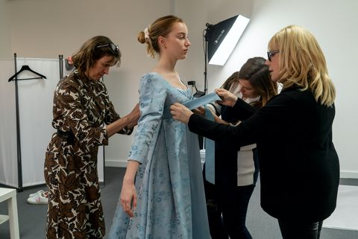
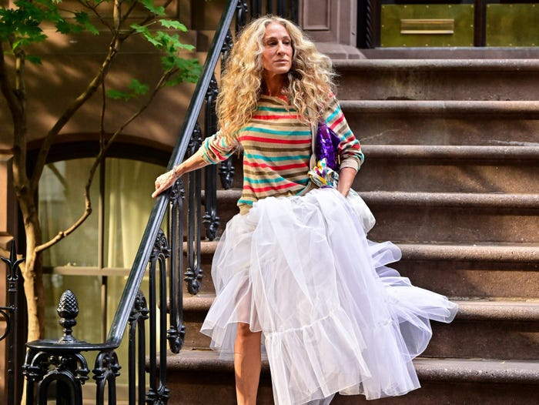
Costume Designer
A costume designer is a person who designs costumes for a film, stage production or television show. The role of the costume designer is to create the characters' outfits/costumes and balance the scenes with texture and colour, etc.^{[1]} The costume designer works alongside the director, scenic, lighting designer, sound designer, and other creative personnel. The costume designer may also collaborate with hair stylist, wig master, or makeup artist. In European theatre, the role is different, as the theatre designer usually designs both costume and scenic elements.
Consumer as designer
The Internet is undoing the industrial revolution's emphasis on mass-produced products; now everybody can get exactly what they want. But designing the product you want is hard, and current design interfaces are not good enough for novice designers

Slide 14
Unit III
Fashion Fairs

Slide 15
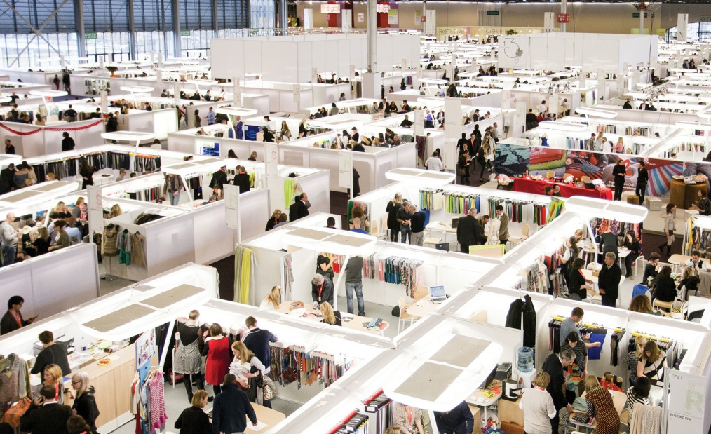
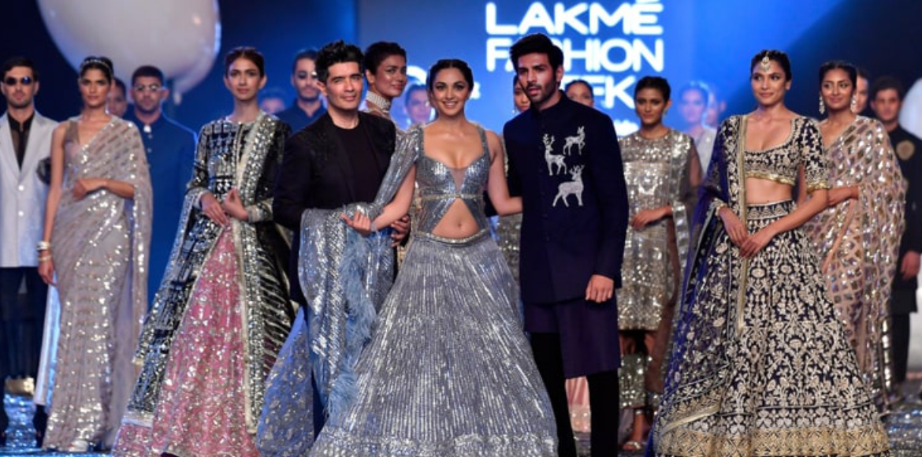
Fashion Fairs
Fashion trade shows
Fashion trade shows are special events where fashion designers and brand owners show off their new fashions to potential clients and retailers, and these events are held all over the world. ... A fashion trade show allows you to select business partners and gain fame in the fashion industry at one convenient location.
Fashion Show
A fashion show is an event put on by a fashion designer to showcase their upcoming line of clothing and/or accessories during Fashion Week. Fashion shows debut every season, particularly the Spring/Summer and Fall/Winter seasons. This is where the latest fashion trends are made.
A fashion show is an event put on by a fashion designer to showcase their upcoming line of clothing and/or accessories during Fashion Week. Fashion shows debut every season, particularly the Spring/Summer and Fall/Winter seasons. This is where the latest fashion trends are made.
And in India, Lakme Fashion Week

Slide 16
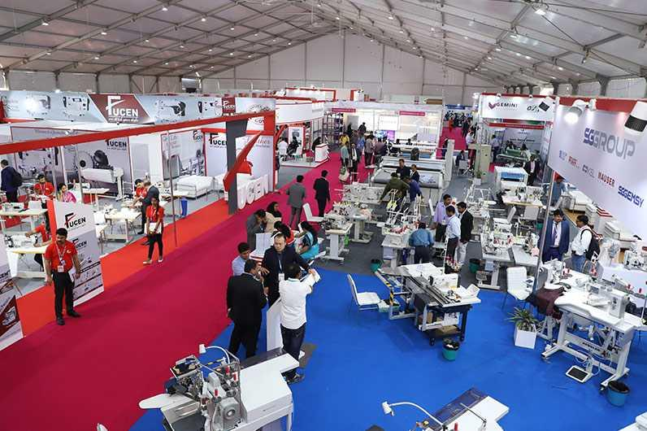
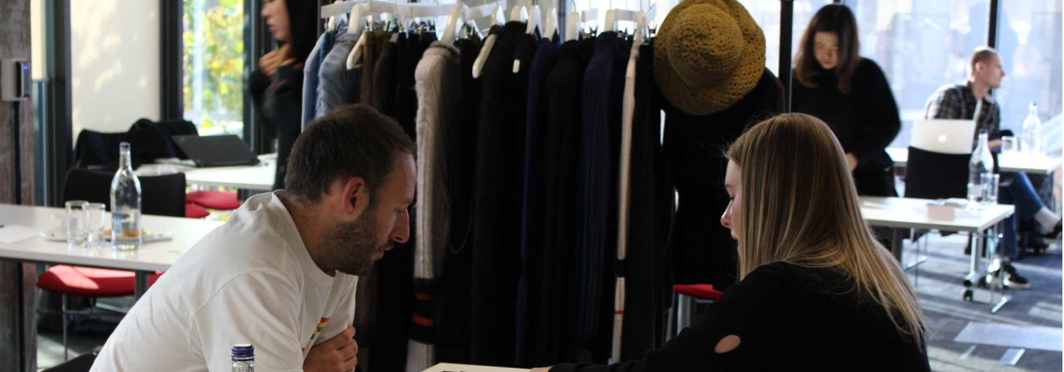
Garment technology fair trade
The show covers all segments of the industry; right from the latest technology machines to machine spares & consumables; from infrastructure set-up to latest processes & systems; from raw materials to trimmings & embellishments; from logistics & packaging solutions to trade communication and documentation services.
Buyer Seller Meet
The Buyer seller meet provides platform for exporters and buyers at one place to meet directly to discuss on business. Such meet helps exporters and buyers to finalize export order also by finalizing terms of delivery, terms of payment and other conditions at one place by avoiding many other communications.

Slide 17
Unit IV
Associations

Slide 18
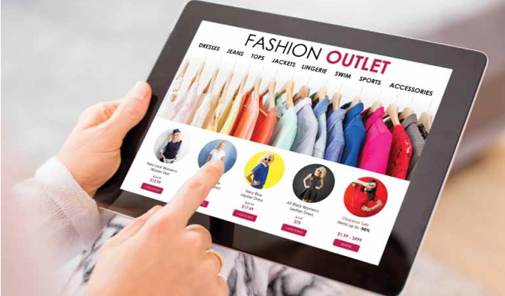
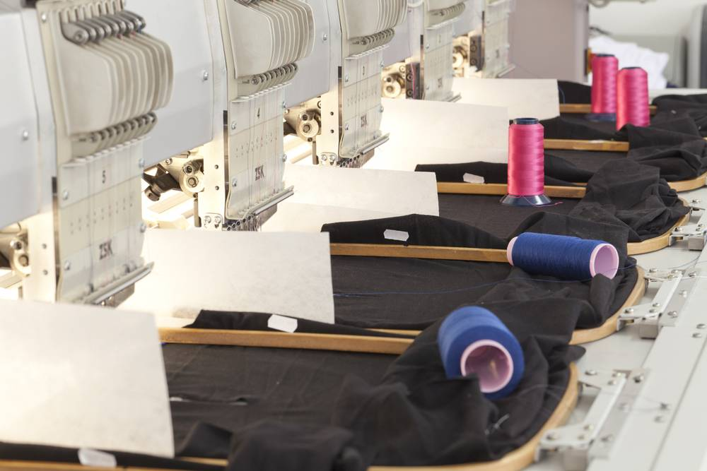
Associations
E commerce in Fashion
E-stores help consumers order fashion products of their choice, sitting right at their home! E-commerce websites also integrate various technologies to their website that assist in the process of shopping.
Fashion ecommerce is helped by growth in several sections of clothing. And whilst growth is slowing in many of them, the projections are still positive. The strongest of those sections is the accessories and bags sector, which grew by a huge 15.6% in 2018 and is projected to still grow by 8.7% by 2022.
Apparel Parks
Considering the stable demand for Indian-made textiles, the central government launched the Apparel Park for Exports scheme
Generally, the size of each park is about 150-250 acres, but the final size is determined on a case-by-case basis
The location of the apparel park should ideally be close to transportation hubs like ports, railway lines or airports. In any case, the park must be well connected and have easy access to such hubs.
Uninterrupted supply of raw material and basic infrastructure facilities near the location would be favourable.
The park will accommodate state-of-the-art apparel manufacturing units, each with a minimum of 200 sewing machines. More emphasis is laid on integrated production units that contain facilities for making ancillary products like buttons, etc

Slide 19
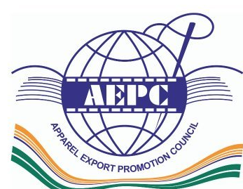


Apparel Export Promotion Council
Export Promotion Councils (EPCs) are organizations set up by the Government of India to help and assist Indian exporters by providing access to international markets, promoting Indian products through various activities and increasing the overall exports from India.
Textile craft Council
And helping them is the Crafts Council of India (CCI), which will conduct the 'Textiles & Accessories' show in Chennai from September 30 to October 1. ... The idea is to nurture heritage weaves and textile traditions and use them to create contemporary products and focus on eco-friendly sustainability.
Research scientists study the technical aspects of fibers and fabrics with the intent of improving existing yarns, fibers, and fabrics in order to create better ones. This research involves developing new fabrics using the most up- to-date chemicals and processes in sectors and areas like
Ahmedabad, Bombay, South India
Synthetic and art silk, Man Made textiles etc.
Textile Research Associations

Slide 20
Unit V
Fashion Centres

Slide 21
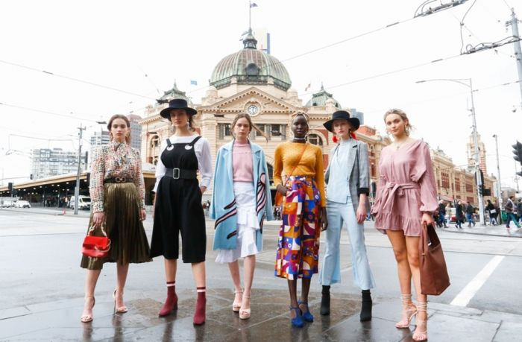
Fashion Centres
Fashion designers tend to gravitate towards the fashion centers of their country, and often overseas, for many reasons, and over the years certain cities have become well known for being the places to be to see the latest fashion trends coming out of the best fashion houses. The following are some of the fashion centers (in no particular order) that are noteworthy:
Melbourne, Australia –
Melbourne has its own group of designers that strongly influence fashion trends both in Australia and New Zealand, but also are open to international designers apparel. On the flipside Melbourne-born Aesop label is still doing extremely well in the worldwide market, dominating the up market skincare and grooming products niche. This is a city for fashionistas to keep an eye on, with exciting things expected ahead.

Slide 22
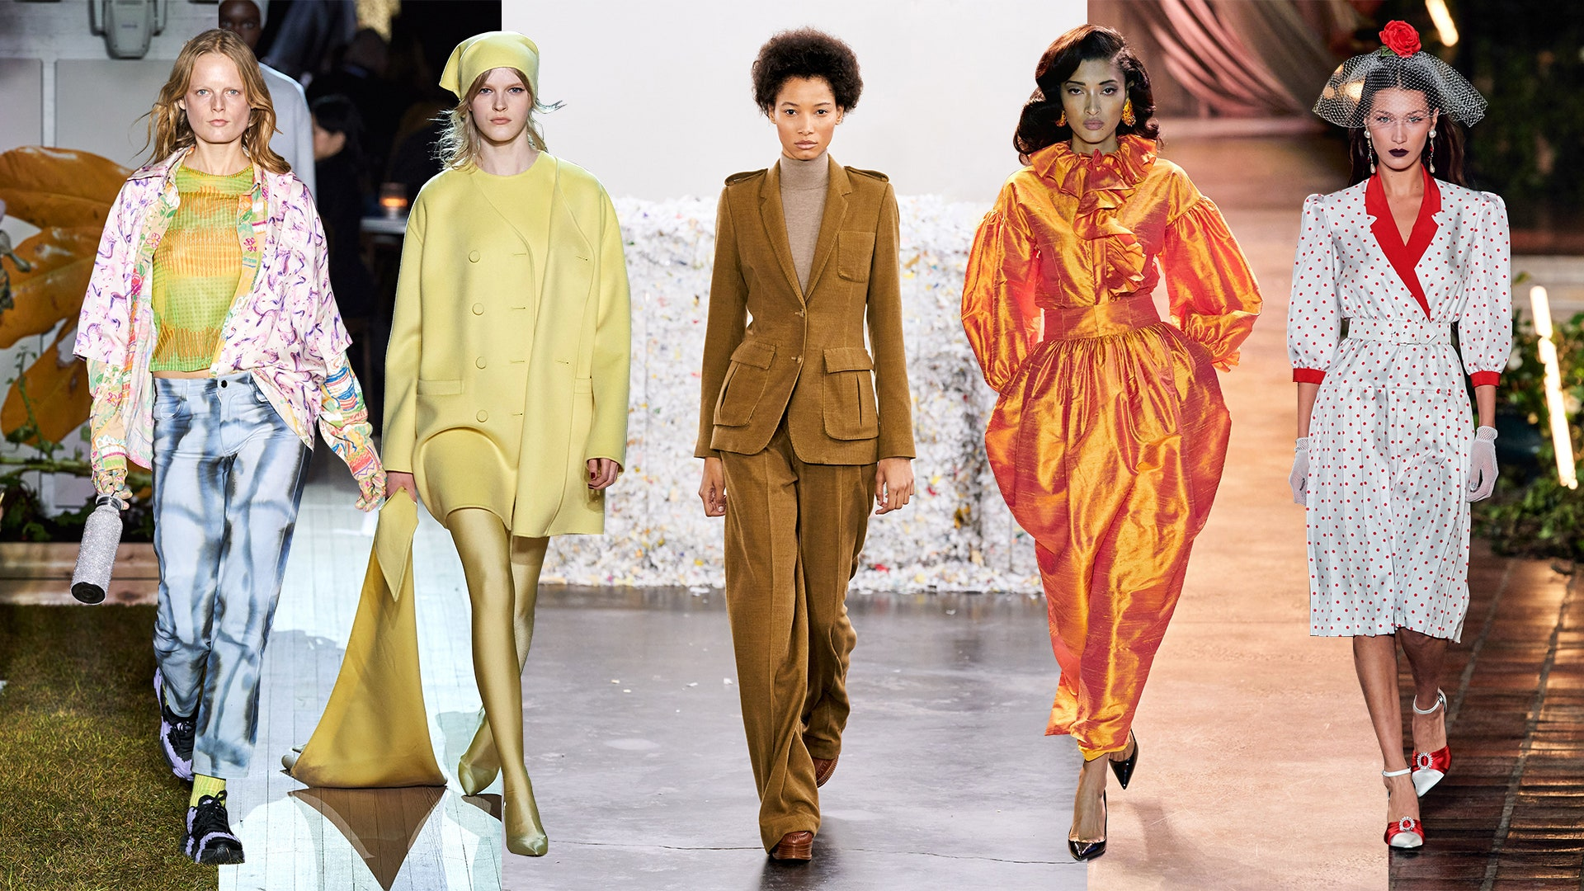
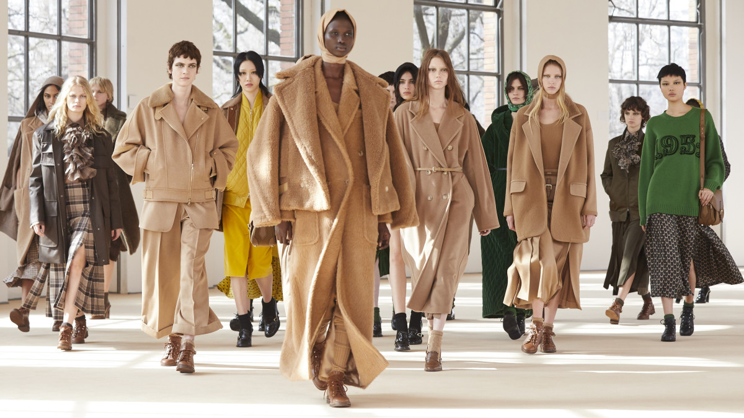
New York, U.S.A.
New York has been seen as one of the world’s major fashion centers for many years and is unlikely to lose that image any time soon. The city is a huge cultural center and designers and others in the fashion industry all turn their eyes to New York when wanting to know what is ‘happening’ today. With a huge number of top designers all operating out of New York, plus a slew of fashion schools with excellent reputations, it is no wonder that the biannual New York Fashion Week attracts thousands of fashion industry personnel from around the world.
Milan Italy
Throughout the decades Milan has been one of the greatest art and fashion cities worldwide and still remains so. Huge designer legends such as Versace, Gucci, Fendi, Armani and Prada all launched from there and are still as popular today as they were when they began dominating fashion show runways in their early days. Milan is a city full of excitement and creativity, and the boutique shopping is sure to satisfy even the most die-hard shopper. Milan is synonymous with luxury brands. Milan Fashion Week is one of the biggest fashion shows in the world, drawing only the most elite fashion industry people.

Slide 23
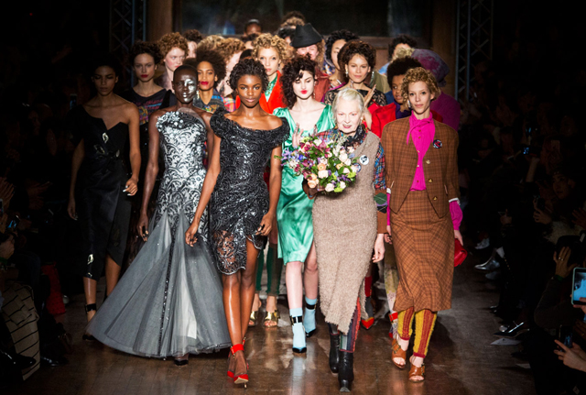
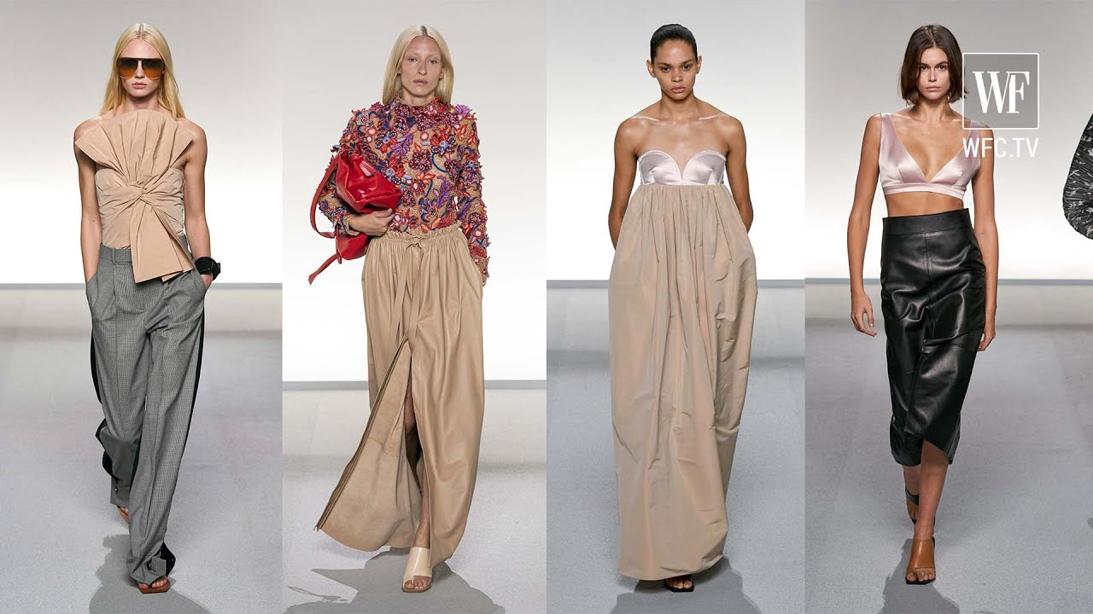
London, England
Just as Paris, France does, London stages a Fashion Week twice a year that draws in designers and those interested in the fashion world from around the globe. Big names such as Jimmy Choo, Stella McCartney, and Vivienne Westwood all operate out of England and are known worldwide. For shoppers London is one of the best places to go to get some serious retail therapy at the many boho boutiques, flagship shops, and the high-street stores that are in plentiful supply. If designer labels are sought Bond Street will provide everything needed.
Paris France
It is not surprising that Paris is on the list of fashion centers as France is home to over 50 fashion learning facilities. YSL, Givenchy, Lagerfeld, Gaultier, Dior, Cardin, Chanel, Lacoste, and Louboutin are all world famous designers that operate out of Paris and are dominating runways at Paris Fashion Week. Elle, the worlds most famous and largest fashion magazine started in Paris and still maintains its headquarters there.

Slide 24
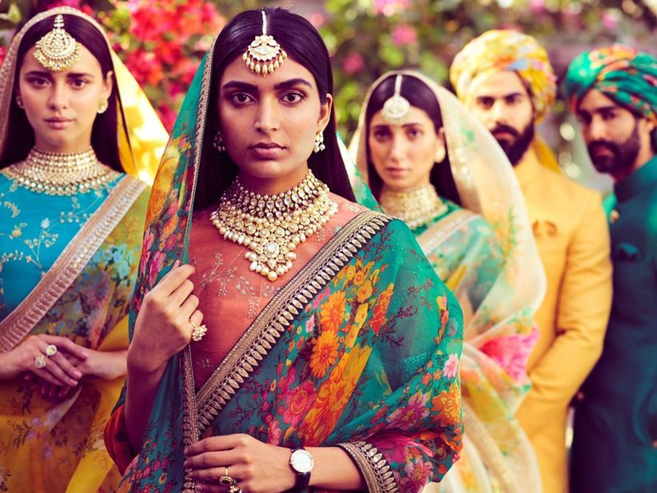
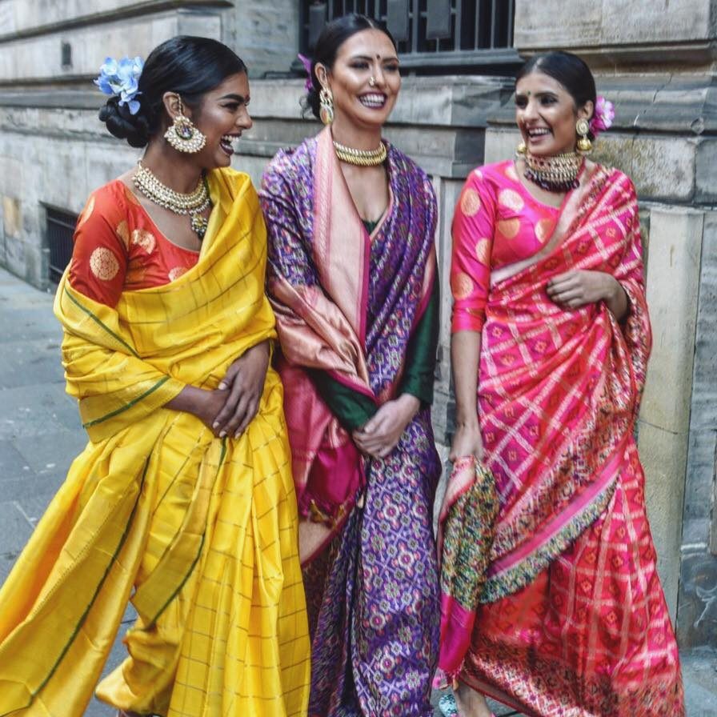
India
India has its own New York, Paris & Milan spread across its different
The most fashionable cities in the country. India is a land of diverse culture and every culture has its own designated ethnic dress. If you scale all the states in the country, you'll be surprised to see how versatile our fashion is. From Kerala's white and golden sarees to Rajasthan's Bandhej print, India boasts about its ever-glowing and ever-colourful fashion.
Designers like Sabyasachi, Ayush Kejriwal are giving an altogether new approach to the roar of fashion and diversity India could offer the next generations and decades to come.

Slide 25
References
https://www.apparelsearch.com/terms/f/fashion_industry_history.html#:~:text=The%20fashion%20industry%20was%20created,clothes%2C%20footwear%2C%20and%20accessories.&text=The%20mass%20production%20of%20clothing,with%20the%20sewer%20or%20tailors.
https://www.indianretailer.com/article/whats-hot/trends/future-trends-fashion-retail-in-2021-beyond.a6721/
https://fashion-history.lovetoknow.com/fashion-clothing-industry/evolution-fashion-industry\
https://www.fibre2fashion.com/industry-article/1603/the-social-effect-of-clothing#:~:text=But%20human%20clothes%20have%20over,sexual%20orientation%20and%20religious%20affiliation.
https://www.garmenttechnologyexpo.com/
https://www.indiafilings.com/learn/apparel-park-scheme/#:~:text=Considering%20the%20stable%20demand%20for,that%20house%20textile%20manufacturing%20units.&text=The%20aim%20is%20to%20create,for%20apparel%20made%20in%20India.
https://www.nativeplanet.com/travel-guide/the-most-fashionable-cities-in-india-005008.html?story=1

Slide 26
Thank You

